Slide 1
Festivals
E-SPACE GROUP CLASS

Slide 2
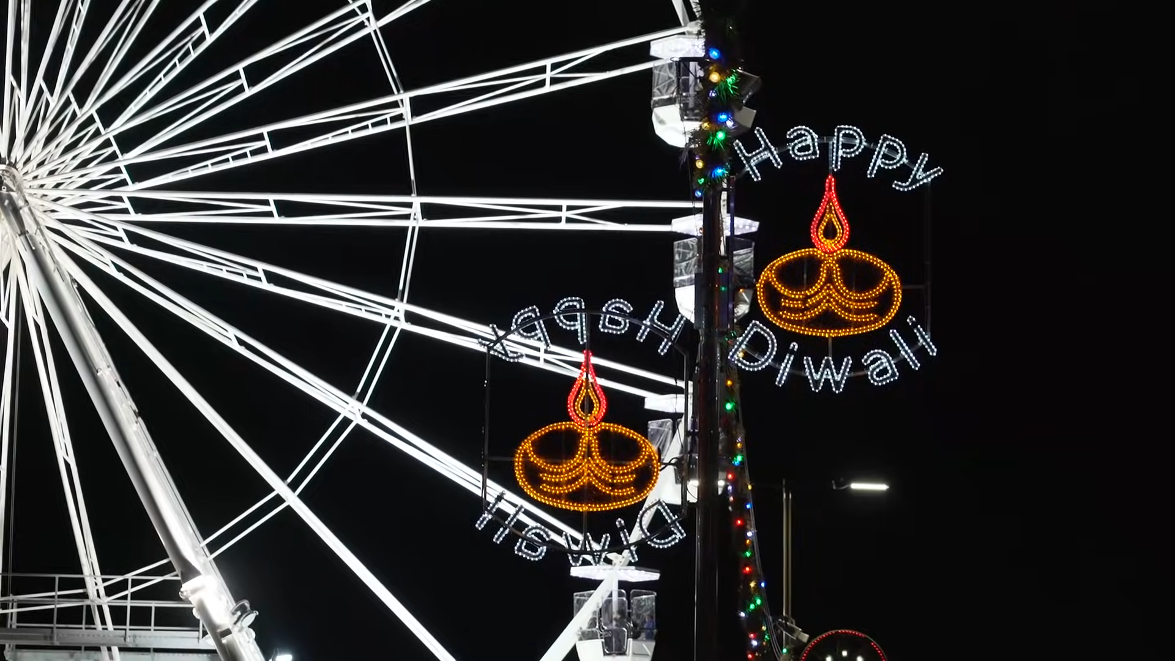
Warm-up activity
Let’s watch a video about Diwali
Notes:
Link to video: https://youtu.be/kjIPGD_WcEY

Slide 3
Warm-up activity
Circle the correct answer about Diwali
Diwali is a festival of ________ .
a. colours
b. lights
c. films
Notes:
Answer: b. lights

Slide 4
Warm-up activity
Circle the correct answer about Diwali
2. Diwali lasts for ________ days .
a. two
b. five
c. ten
Notes:
Answer: b. five

Slide 5
Warm-up activity
Circle the correct answer about Diwali
3. Diwali is celebrated by ________ of people around the world.
a. hundreds
b. thousands
c. millions
Notes:
Answer: c. millions

Slide 6
Warm-up activity
Circle the correct answer about Diwali
4. People celebrated Diwali by lighting up ________ .
a. lamps
b. matches
c. barbecues
Notes:
Answer: a. lamps

Slide 7
Warm-up activity
Circle the correct answer about Diwali
5. Diwali is an important time for ________ .
a. families
b. pets
c. students
Notes:
Answer: a. families

Slide 8
Conversation Questions
Do you enjoy attending festivals?
What special food and activities do you have for these festivals?
How do you celebrate Spring Festival?
What is your favorite festival?
Why do you think festivals are important?

Slide 9
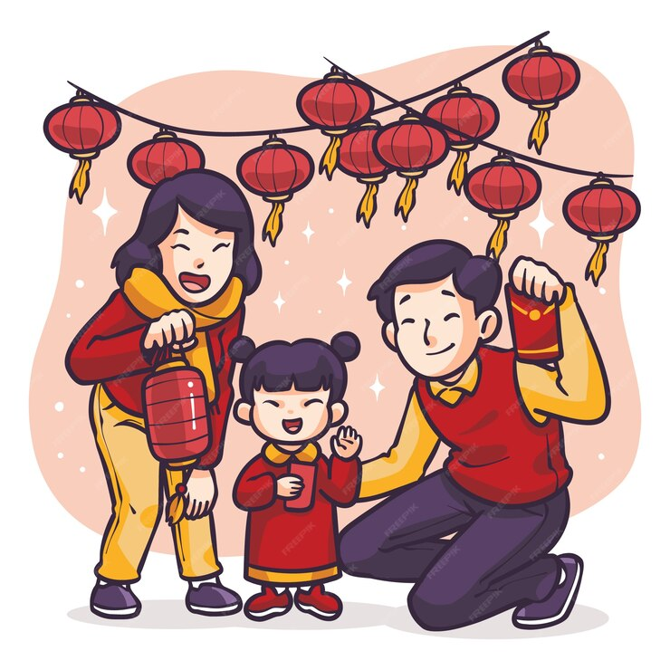
Discussion Topic
Describe a festival in your country.
You should say:
What the festival is
When and where it is celebrated
How people celebrate it, and
Why this festival is important in your country

Slide 10
Thank you
FOR LISTENING!

